Slide 1

SECURITY ASSESSMENT
Parakh Shinde
[CBS-0407]

Slide 2
Project Scenario

Slide 3
Overview
As the lead security engineer for CryptoV4ult, a prominent international cryptocurrency platform, you're tasked with ensuring the security and integrity of our newly established infrastructure. With over 1 million users relying on our services, it's imperative that we maintain the highest standards of security to protect their digital assets.
Your role involves a comprehensive review of the security landscape for our new application technology stack, identifying potential vulnerabilities, and running scans to assess any existing threats. Your scope encompasses various entities within our architecture, including the application itself, containerized services, and the external-facing API.
Ultimately, your objective is to develop a robust remediation plan that not only addresses current vulnerabilities but also strengthens our overall security posture, safeguarding both user data and the platform's reputation. This critical mission presents an exciting opportunity to leverage your skills and expertise in cybersecurity to fortify our infrastructure and uphold our commitment to providing a secure and reliable platform for our users. Let's embark on this journey together to ensure CryptoV4ult remains a trusted leader in the cryptocurrency industry!

Slide 4
Section 1:
Integrating SDLC (20)

Slide 5
Transitioning to Secure SDLC
Requirements Analysis
Tasks: Conduct user interviews to gather functional requirements. Write a requirements document for task management features. Added Security Task: Perform Security Requirements and Threat Analysis to identify potential risks, such as unauthorized access and data leakage. Explanation: At this stage, we define security and compliance goals. This ensures that confidentiality, integrity, and availability are considered before design begins.
Design
Tasks: Create a high-level architecture diagram for the application. Design the database schema for tasks. Added Security Task: Review Secure Architecture and Data Flow to ensure encryption and proper access control mechanisms are integrated. Explanation: The design phase focuses on including security principles like least privilege, defense in depth, and secure data storage to strengthen the system’s architecture.

Slide 6
Transitioning to Secure SDLC
Development
Tasks: Code the user interface using HTML and CSS. Implement interactive elements using JavaScript. Set up a Flask application to handle API requests. Implement CRUD operations for tasks. Added Security Task: Use Secure Coding Practices and perform Static Code Analysis to identify and fix vulnerabilities early. Explanation: Secure development ensures that code follows OWASP Top 10 principles. This reduces risks such as SQL injection, XSS, or authentication bypass.
Testing
Tasks: Write and execute functional test cases. Conduct browser compatibility testing. Added Security Task: Conduct Penetration Testing and Vulnerability Scanning to find weaknesses in authentication, API endpoints, and session handling. Explanation: Testing now includes both functional and security validation. This makes sure the platform resists common attacks before deployment.

Slide 7
Transitioning to Secure SDLC
Deployment
Tasks: Deploy the application to Heroku. Perform smoke testing on the deployed application. Added Security Task: Implement a Secure Deployment Configuration, including HTTPS enforcement and protection of environment secrets. Explanation: Deployments must follow hardened configurations. This ensures the production environment adheres to the principle of least privilege and uses encrypted communications.
Maintenance
Tasks: Monitor application logs and fix reported issues. Gather user feedback for future feature additions. Added Security Task: Establish Continuous Security Monitoring and Patch Management to track vulnerabilities and apply updates promptly. Explanation: Ongoing maintenance ensures that new vulnerabilities are quickly addressed and the platform stays secure against emerging threats.

Slide 8
Advocating for Secure SDLC
1. Early Detection of Vulnerabilities
Security issues are found during development instead of after deployment. This cuts down on risk and costs for fixing problems.
2. Continuous Security Integration
Security checks happen at every stage. This ensures ongoing protection for CryptoV4ult’s changing infrastructure.
3. Improved Compliance and Governance
Adding security controls helps meet important rules and data protection needs for cryptocurrency operations
4. Enhanced Risk Management
Proactive threat modeling and testing boost defenses against cyberattacks aimed at user data and digital assets.
5. Increased Trust and Reliability
Showing a security-first development culture builds customer confidence and protects CryptoV4ult’s reputation.

Slide 9
Section 2:
Vulnerabilities and Remediation (35)

Slide 10
Vulnerabilities and remediation
As CryptoV4ult enhances its infrastructure to support new features for its extensive user base, ensuring the security of user authentication mechanisms is paramount. The login system is critical to the platform's security, acting as the first line of defense against unauthorized access. Your task is to scrutinize a login system, identify 3 potential vulnerabilities they usually have, and propose effective remediation strategies.
Concentrate on login systems in general
The vulnerability can relate to any aspect of a login system, including user identification, authentication mechanisms, and session management
Any common login system vulnerability is acceptable
For each identified potential vulnerability, you need to:
  Describe the vulnerability
  Explain the risk
  Provide remediation strategy

Slide 11
Vulnerabilities and remediation
1. SQL Injection
Description
This issue happens when user input fields, like username or password, are not cleaned properly. Attackers can then insert harmful SQL queries into the authentication database.
Risk
An attacker could get around authentication, steal sensitive data like user credentials, or change database entries. This could result in a major data breach and loss of user trust.
Remediation
Use parameterized queries or prepared statements instead of dynamic SQL. Implement input validation and output encoding. Regularly conduct code reviews and database vulnerability scans to find injection flaws.

Slide 12
Vulnerabilities and remediation
2. Weak Password Policy
Description
Login systems that let users create simple, short, or common passwords raise the chances of brute-force or credential stuffing attacks.
Risk
Weak passwords make it easy for attackers to gain unauthorized access, break into multiple accounts, and carry out fraudulent transactions.
Remediation
Enforce a strong password policy with a minimum of 12 characters, including upper and lowercase letters, numbers, and symbols. Implement multi-factor authentication (MFA) to provide an additional layer of protection. Educate users by using password strength indicators and security prompts.

Slide 13
Vulnerabilities and remediation
3. Session Hijacking
Description
This happens when attackers steal valid session tokens through cookies, network sniffing, or cross-site scripting. They then use these tokens to impersonate real users.
Risk
Attackers can gain complete access to user accounts. They can perform unauthorized actions, such as making transactions or changing account details.
Remediation
Use secure, HTTP-only, and same-site cookies for session tokens. Enforce session expiration and automatic logout after inactivity. Implement HTTPS encryption across the entire site and regenerate session IDs after login.

Slide 14
Create a threat Matrix
Dissect and categorize the 3 vulnerabilities that you have identified for the login system. Understanding these vulnerabilities from a strategic viewpoint will enable the company to allocate resources efficiently, prioritize remediation efforts, and maintain CryptoV4ult's reputation as a secure and reliable platform.
For each identified vulnerability, critically assess its potential to disrupt CryptoV4ult's operational functionality, erode customer trust, and impact financial stability. Assign an impact level of 'Low', 'Medium', or 'High' based on the evaluated potential consequences.
Analyze the complexity and feasibility of exploiting each identified vulnerability. Consider the sophistication required for exploitation and the accessibility of the vulnerability to potential attackers. Rate the likelihood of exploitation as 'Low', 'Medium', or 'High'.
Utilize the provided risk matrix framework to map out the vulnerabilities according to your assessments of their impact and exploit likelihood.

Slide 15
Threat Matrix
Pathway (Vulnerability) | Impact Level | Likelihood Level
SQL Injection | High | Medium
Weak Password Policy | Medium | High
Session Hijacking | High | Medium
Impact | Low | Medium | High
Likelihood
High |  | Weak Password Policy
Medium |  |  | SQL Injection Session Hijacking
Low

Slide 16
Section 3:
Container Security (20)

Slide 17
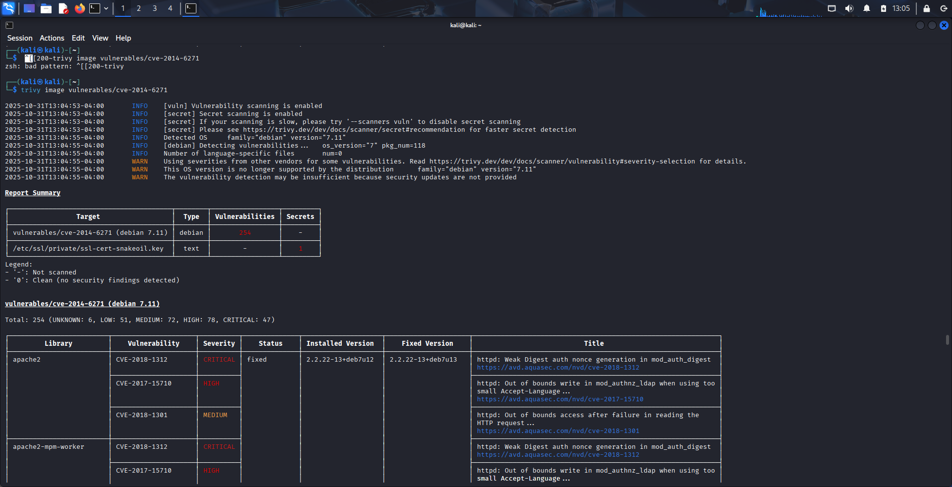
Trivy scan screenshot
Place a screenshot from the Trivy scan results on this slide. Make sure your hostname is clearly visible.

Slide 18
Report to Fix Container Issues
Vulnerability Name | Unpatched Software Version | Patched Software Version
CVE-2018-11236 | version 2.27 | Fixed versions: Debian bullseye – 2.31-13+deb11u11 and later.
CVE-2021-33574 | versions 2.32 and 2.33 | Fixed in versions: Debian bullseye security 2.31-13+deb11u13, bookworm 2.36-9+deb12u10.
CVE-2018-1000654 (Python / libtasn1 category) | libtasn1-4.12 / 4.13 | Patched versions not consistently listed; vendors indicate upgrades of libtasn1 and related packages needed.
CVE-2017-9049 (libxml2) | libxml2 version 2.9.4+dfsg-7ubuntu1 | Fixed in versions: libxml2 2.9.4
CVE-2014-6271 (bash – Shellshock) | Bash versions up to 4.3-7ubuntu1 | Patched versions: On Ubuntu 18.04 scope, Bash updated to 4.3-7ubuntu1.8 or newer.
CVE-2020-1971 (OpenSSL) | OpenSSL version 1.1.1-1ubuntu2 | Patched version: 1.1.1f-1ubuntu2.7.
CVE-2019-18276 (bash) | Bash version 4.3-7ubuntu1 | Patched version: 4.3-7ubuntu1.9).

Slide 19
Section 4:
API Security (15)

Slide 20
API Security
Management has partnered with an external sales vendor and asked for a generic API to be developed that tracks user’s data. Based on the data ingested they will create targeted sales advertisements to the customer base, this means a lot of confidential info about the users will be shared to 3rd party vendors.
You need to identify 3 common API vulnerabilities and propose effective remediation strategies. Keep in mind this code does not exist; this is the initial stages of development, and you are providing guidance to the engineering team. Feel free to make any assumptions about API features, implementations, and what private data might be shared.
For each identified common API vulnerability:
  Describe the vulnerability
  Explain the risk
  Provide remediation strategy

Slide 21
Vulnerabilities and remediation
1. Broken Authentication
Description
This vulnerability happens when API endpoints that handle authentication, like login or token generation, are not securely designed. For instance, using predictable tokens, missing rate limits, or not validating sessions correctly can lead to weaknesses.
Risk
Attackers could impersonate real users or administrators by stealing or creating access tokens. This could result in data being exposed or unauthorized actions, like transferring funds or changing customer profiles.
Remediation
Implement strong authentication methods such as OAuth 2.0 or OpenID Connect. Use short-lived access tokens and secure refresh token rotation. Apply rate limiting and IP throttling to stop brute-force attacks. Enforce TLS (HTTPS) for all authentication-related endpoints.

Slide 22
Vulnerabilities and remediation
2. Excessive Data Exposure
Description
APIs often send back more data than needed, expecting clients to filter out the unwanted fields. This exposes sensitive user information, like personal IDs, transaction history, or wallet addresses, to anyone who can access the API.
Risk
Exposing unnecessary data might lead to privacy violations, data breaches, or exploitation by malicious third parties. This can harm user trust and violate data protection laws like GDPR.
Remediation
Implement output data filtering on the server side and return only the necessary fields. Apply object-level access controls so users can only access their own data. Conduct audits of API responses to ensure no sensitive information is shared accidentally. Encrypt sensitive data both during transmission and while stored.

Slide 23
Vulnerabilities and remediation
3. Lack of Rate Limiting and Input Validation
Description
If an API allows unlimited requests or does not validate input correctly, attackers can take advantage by sending excessive traffic, leading to denial-of-service attacks, or injecting harmful payloads, such as JSON or command injections.
Risk
This can cause system outages, data corruption, or jeopardize API availability, which directly impacts CryptoV4ult’s user experience and reputation.
Remediation
Enforce rate limiting, request throttling, and CAPTCHA for suspicious patterns. Implement input validation and sanitization for all API parameters and payloads. Deploy Web Application Firewall (WAF) or API Gateway rules to block unusual request behavior. Monitor logs for misuse and automatically blacklist harmful IP addresses

